Slide 1


Synergies Team
Final Project
Bank Customer Churn Prediction
A study case to predict whether the customer will most likely churn or not.

Slide 2

What is the
problem?
Customer’s churned
20.4%
Data historis Rakamin Bank Center menunjukkan tingkat churn 20,37%, melebihi toleransi maksimal 10 - 15 %. Implementasi model ML diharapkan membantu tim bisnis mengatasi nasabah yang berpotensi churn.
79.6%
Customer’s retained
– Bank Customer Churn Prediction
A study case to predict whether the customer will most likely churn or not.

Slide 3


Our
workflow
Dataset Overview
Goal & Objective
EDA – Business Insight
Modelling & Evaluation
Data Pre-processing
Modelling & Evaluation
Feature Importance
Business Recommendation
– Bank Customer Churn Prediction
A study case to predict whether the customer will most likely churn or not.

Slide 4





Dataset
Overview
Berikut ini adalah dataset dari
Rakamin Bank Center.
Age Range
Customer
Product
Activity
Location
Nasabah berusia 18 – 92 tahun.
Terdapat 10K total nasabah.
Bank memiliki 4 produk layanan.
Sebanyak 51% adalah nasabah aktif.
Nasabah berasal dari 3 negara berbeda.
– Bank Customer Churn Prediction
A study case to predict whether the customer will most likely churn or not.

Slide 5


A goal to help
to solve the problem
Goal
Menurunkan tingkat churn rate nasabah menjadi dibawah 15% dalam kurun waktu satu tahun.
Objective
Membuat Model Klasifikasi untuk membantu Rakamin Bank Center dalam memprediksi nasabah yang akan churn sehingga diharapkan mampu menurunkan tingkat churn rate dibawah 15%.
– Bank Customer Churn Prediction
A study case to predict whether the customer will most likely churn or not.

Slide 6


Metrics
we use
Business Metric
Evaluation Metric
Churn Rate
F1 Score
– Bank Customer Churn Prediction
A study case to predict whether the customer will most likely churn or not.

Slide 7
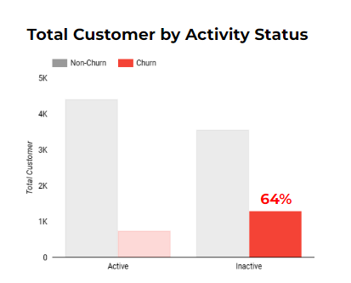
Business
Insights
After EDA
Sebanyak 64% nasabah churn disebabkan karena tidak aktif kembali dalam melakukan aktivitas transaksi.
– Bank Customer Churn Prediction
A study case to predict whether the customer will most likely churn or not.

Slide 8
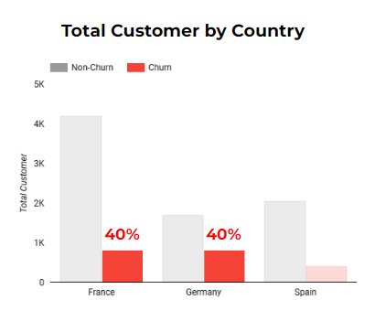
Business
Insights
After EDA
Sekitar 80% nasabah churn berasal dari Negara Prancis dan Jerman.
– Bank Customer Churn Prediction
A study case to predict whether the customer will most likely churn or not.

Slide 9
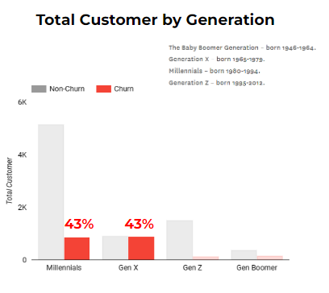
Business
Insights
After EDA
Akumulasi persentase dari nasabah churn sekitar 86% yang berasal dari generasi Millenials dan generasi X.
– Bank Customer Churn Prediction
A study case to predict whether the customer will most likely churn or not.

Slide 10
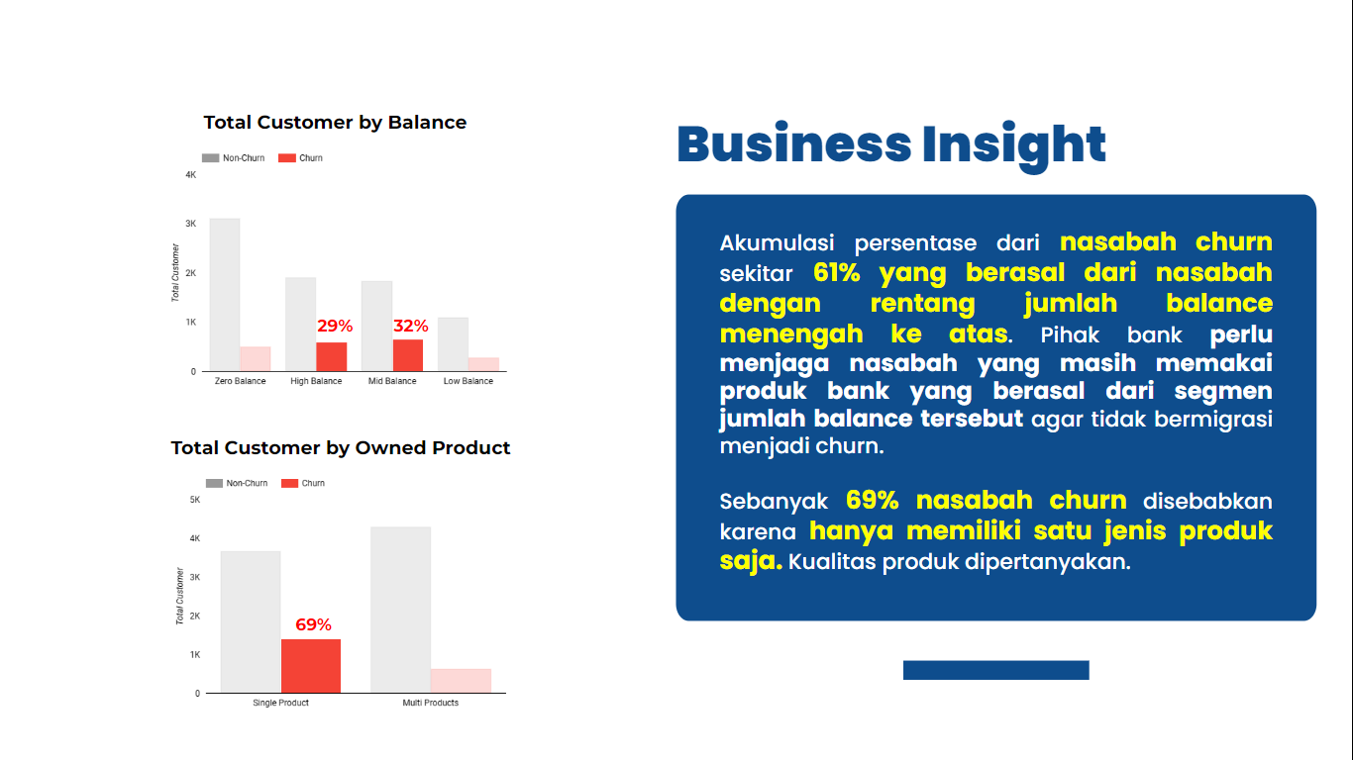
Business
Insights
After EDA
Sekitar 61% nasabah churn berasal dari nasabah dengan rentang balance menengah ke atas.
– Bank Customer Churn Prediction
A study case to predict whether the customer will most likely churn or not.

Slide 11
Business
Insights
After EDA
Sebanyak 69% nasabah churn disebabkan karena hanya memiliki satu jenis produk saja.
– Bank Customer Churn Prediction
A study case to predict whether the customer will most likely churn or not.

Slide 12
Data
Pre-Processing
Variabel target untuk machine learning adalah "exited“. Metode yang digunakan adalah supervised learning karena labelnya telah ada, dan karena nilainya bersifat kategorikal, metode yang dipilih adalah klasifikasi.
Selection
Duplicate
Convertion
Splitting
Outlier
Scaling
Menghapus fitur yang tidak berguna.
Menghapus data duplikat.
Mengonversi fitur kategori menjadi numeric.
Membagi data training dan testing.
Menghapus outliers pada data.
Melakukan scaling data.
– Bank Customer Churn Prediction
A study case to predict whether the customer will most likely churn or not.

Slide 13
Data
Pre-Processing
Before
After
Column | Non-Null Count | DType
RowNumber | 10000 non-null | int64
CustomerID | 10000 non-null | int64
Surname | 10000 non-null | object
CreditScore | 10000 non-null | int64
Geography | 10000 non-null | object
Gender | 10000 non-null | object
Age | 10000 non-null | int64
Tenure | 10000 non-null | int64
Balance | 10000 non-null | float64
NumOfProducts | 10000 non-null | int64
HasCrCard | 10000 non-null | int64
isActiveMember | 10000 non-null | int64
EstimatedSalary | 10000 non-null | float64
Exited | 10000 non-null | int64
Column | Non-Null Count | DType
CreditScore | 6906 non-null | float64
Gender | 6906 non-null | float64
Age | 6906 non-null | float64
Tenure | 6906 non-null | float64
Balance | 6906 non-null | float64
NumOfProducts | 6906 non-null | float64
HasCrCard | 6906 non-null | float64
isActiveMember | 6906 non-null | float64
EstimatedSalary | 6906 non-null | float64
is_France | 6906 non-null | float64
is_Germany | 6906 non-null | float64
is_Spain | 6906 non-null | float64
– Bank Customer Churn Prediction
A study case to predict whether the customer will most likely churn or not.

Slide 14
Modelling &
Evaluation
Machine Learning Algorithms
Logistic Regresion
Random Forest
KNN
AdaBoost
SVM
XGBoost
Decision Tree
– Bank Customer Churn Prediction
A study case to predict whether the customer will most likely churn or not.

Slide 15
Evaluation Metrics
Comparison
Model | Before Hyperparameter Tuning
 | F1-Score |  | Recall |  | ROC-AUC
 | Train | Test | Train | Test | Train | Test
Logistic Regression | 47 | 47 | 38 | 37 | 77 | 77
KNN | 71 | 68 | 53 | 50 | 92 | 79
SVM | 66 | 63 | 56 | 53 | 88 | 84
Decision Tree | 100 | 57 | 100 | 58 | 100 | 70
Random Forest | 100 | 65 | 100 | 57 | 100 | 86
Adaboost | 66 | 65 | 59 | 58 | 86 | 85
Xgboost | 93 | 65 | 90 | 59 | 99 | 85
– Bank Customer Churn Prediction
A study case to predict whether the customer will most likely churn or not.

Slide 16
Evaluation Metrics
Comparison
Model | After Hyperparameter Tuning
 | F1-Score |  | Recall |  | ROC-AUC
 | Train | Test | Train | Test | Train | Test
Logistic Regression | 47 | 47 | 38 | 37 | 77 | 77
KNN | 57 | 54 | 46 | 42 | 86 | 82
SVM | 70 | 64 | 6 | 55 | 90 | 84
Decision Tree | 65 | 64 | 58 | 56 | 85 | 83
Random Forest | 64 | 64 | 72 | 72 | 82 | 82
Adaboost | 66 | 65 | 59 | 58 | 86 | 85
Xgboost | 63 | 62 | 53 | 53 | 85 | 85
– Bank Customer Churn Prediction
A study case to predict whether the customer will most likely churn or not.

Slide 17
Evaluation Metrics
Comparison
Decision Tree
Before Hyperparameter Tuning |  | After Hyperparameter Tuning
F1-Score (train) | 100 | F1-Score (train) | 65
F1-Score (test) | 57 | F1-Score (test) | 64
Recall (train) | 100 | Recall (train) | 58
Recall (test) | 58 | Recall (test) | 56
ROC_AUC (train) | 100 | ROC_AUC (train) | 85
ROC_AUC (test) | 70 | ROC_AUC (test) | 83
Note.
Setelah hyperparameter tuning, model meningkatkan semua evaluasi metrik kecuali ROC-AUC. Overfitting berhasil diatasi, model jadi pilihan untuk memprediksi churn.
Parameter tuning:
max_leaf_nodes : 15 - 20
min_samples_leaf : 30 - 35
min_samples_split : 170 - 175
max_depth : 3 - 8
Confusion Matrix
True Positif | 1126
True Negatif | 4393
False Positif | 347
False Negatif | 993
– Bank Customer Churn Prediction
A study case to predict whether the customer will most likely churn or not.

Slide 18
Evaluation Metrics
Comparison
Random Forest
Before Hyperparameter Tuning |  | After Hyperparameter Tuning
F1-Score (train) | 100 | F1-Score (train) | 64
F1-Score (test) | 65 | F1-Score (test) | 64
Recall (train) | 100 | Recall (train) | 72
Recall (test) | 57 | Recall (test) | 72
ROC_AUC (train) | 100 | ROC_AUC (train) | 82
ROC_AUC (test) | 86 | ROC_AUC (test) | 82
Note.
Setelah hyperparameter tuning, hanya Recall yang meningkat di model. Overfitting diatasi, model dipilih untuk memprediksi churn karena skor Recall dan ROC-AUC mencapai di atas 70%, mendukung skor F1.
Parameter tuning:
class_weight : balanced
max_samples : 0.075 - 0.085
max_leaf_nodes : 2
min_samples_split : 290 - 295
min_weight_fraction_leaf : 0.05 - 0.1
Confusion Matrix
True Positif | 1484
True Negatif | 3620
False Positif | 1120
False Negatif | 545
– Bank Customer Churn Prediction
A study case to predict whether the customer will most likely churn or not.

Slide 19
Evaluation Metrics
Comparison
AdaBoost
Before Hyperparameter Tuning |  | After Hyperparameter Tuning
F1-Score (train) | 66 | F1-Score (train) | 66
F1-Score (test) | 65 | F1-Score (test) | 65
Recall (train) | 59 | Recall (train) | 59
Recall (test) | 58 | Recall (test) | 58
ROC_AUC (train) | 86 | ROC_AUC (train) | 86
ROC_AUC (test) | 85 | ROC_AUC (test) | 85
Note.
Tidak ada perbedaan hasil setelah hyperparameter tuning, namun dapat dipertimbangkan sebagai model yang dipilih untuk memprediksi churn.
Parameter tuning:
n_estimators : 50 - 55
Confusion Matrix
True Positif | 1182
True Negatif | 4334
False Positif | 406
False Negatif | 847
– Bank Customer Churn Prediction
A study case to predict whether the customer will most likely churn or not.

Slide 20
Evaluation Metrics
Comparison
Random Forest
AdaBoost
Decision Tree
F1-Score (train) | 64
F1-Score (test) | 64
Recall (train) | 72
Recall (test) | 72
ROC_AUC (train) | 82
ROC_AUC (test) | 82
F1-Score (train) | 66
F1-Score (test) | 65
Recall (train) | 59
Recall (test) | 58
ROC_AUC (train) | 86
ROC_AUC (test) | 85
F1-Score (train) | 65
F1-Score (test) | 64
Recall (train) | 58
Recall (test) | 56
ROC_AUC (train) | 85
ROC_AUC (test) | 83
Kuat terhadap outliers
Bekerja dengan baik dengan data non-linear
Risiko overfitting lebih rendah
Efisien pada kumpulan data yang besar
Skor F1 tinggi
Efektif dalam menangani data yang kompleks
Mengurangi resiko overfitting
Skor F1 tinggi
Tingkat konvergensi dan generalisasinya sangat baik
Robust terhadap outliers
– Bank Customer Churn Prediction
A study case to predict whether the customer will most likely churn or not.

Slide 21
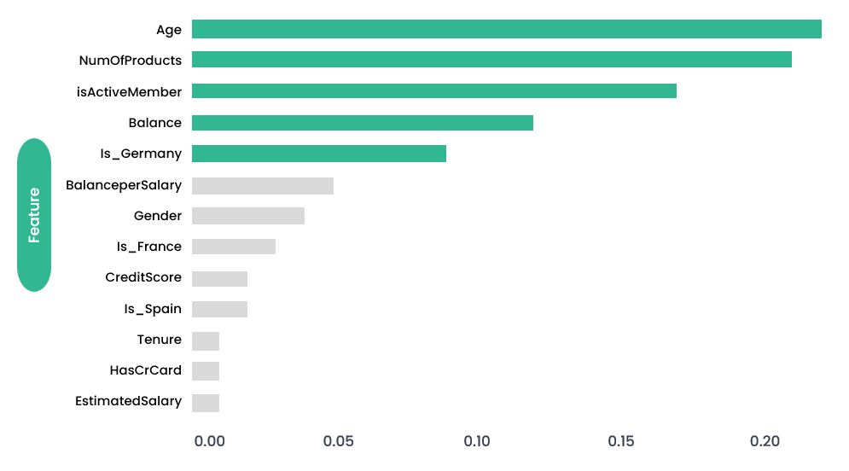
Feature
Importance
– Bank Customer Churn Prediction
A study case to predict whether the customer will most likely churn or not.

Slide 22
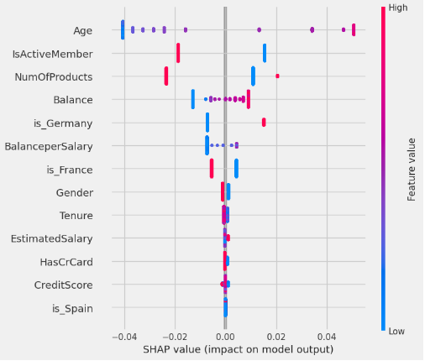
SHAP
Value
– Bank Customer Churn Prediction
A study case to predict whether the customer will most likely churn or not.

Slide 23
SHAP value
Information
pelanggan yang lebih tua cenderung churn
pelanggan yang tidak aktif cenderung churn
lebih sedikit produk dari pelanggan yang cenderung churn
semakin banyak saldo dari akun pelanggan, semakin banyak pula yang cenderung churn
pelanggan dari jerman cenderung churn
semakin banyak gaji yang disimpan pelanggan ke rekening mereka, semakin banyak dari mereka yang cenderung melakukan churn
pelanggan dari Perancis cenderung dipertahankan
Pelanggan wanita cenderung churn
semakin sedikit kepemilikan dari pelanggan, semakin banyak dari mereka yang cenderung melakukan churn
gaji, kartu kredit, skor kredit, dan warga spanyol tidak mempengaruhi apakah pelanggan akan churn atau tidak
– Bank Customer Churn Prediction
A study case to predict whether the customer will most likely churn or not.

Slide 24
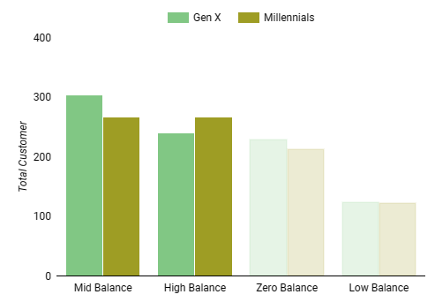
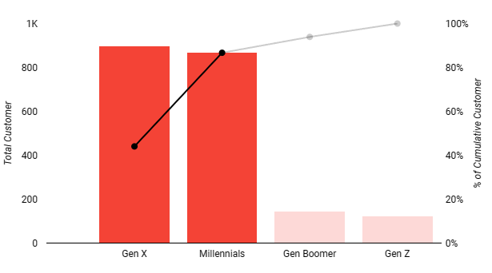
Business
Insights
Based on SHAP
Total Churned Customer by Generations
Total Churned Customer by Balance Group
in Millennials and Gen X
lebih dari 80% nasabah churn berasal dari generasi X dan millenials. Sebanyak 53% nasabah churn pada generasi Millennials dan generasi X memiliki rentang jumlah balance menengah ke atas.
– Bank Customer Churn Prediction
A study case to predict whether the customer will most likely churn or not.

Slide 25
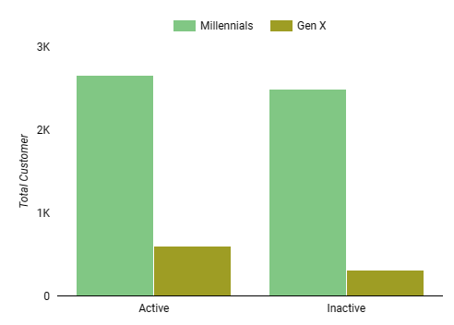
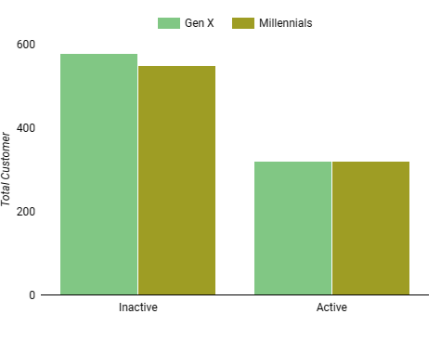
Business
Insights
Based on SHAP
Total Churned Customer by Status Activity
in Millennials and Gen X
Total Retained Customer by Status Activity
in Millennials and Gen X
Terlihat bahwa generasi millenials dan generasi X yang sudah tidak menggunakan produk bank salah satunya adalah karena banyak yang tidak aktif kembali dalam melakukan aktivitas transaksinya.
– Bank Customer Churn Prediction
A study case to predict whether the customer will most likely churn or not.

Slide 26
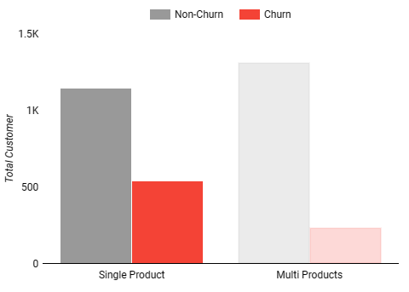
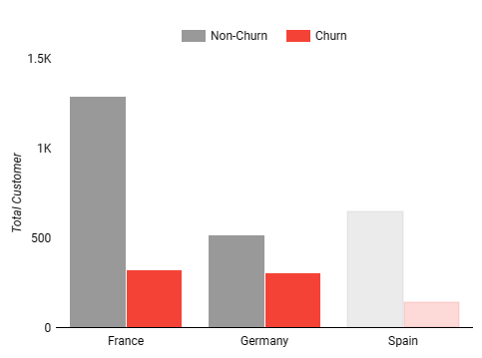
Business
Insights
Based on SHAP
Total Customer by Owned Product
(Filtered by Millenials and Gen X)
Total Customer by Country
(Filtered by Millenials and Gen X)
Nasabah churn dari generasi millenials dan gen x banyak menggunakan satu jenis produk saja. Nasabah churn dari generasi milenials dan gen x banyak terjadi pada negara prancis dan jerman.
– Bank Customer Churn Prediction
A study case to predict whether the customer will most likely churn or not.

Slide 27

So, we now
know…
Berdasarkan business insight dan SHAP value tadi, maka strategi pemasaran atau bisnis bisa kita pusatkan pada kelompok nasabah berikut.
Age Range
Product
Balance
Location
Berasal dari generasi millennial dan X.
Menggunakan hanya 1 produk layanan.
Memiliki saldo menengah dan tinggi.
Nasabah berasal dari negara Jerman
– Bank Customer Churn Prediction
A study case to predict whether the customer will most likely churn or not.

Slide 28



Business
Recommendations
Berikut adalah business recommendtaions berdasarkan business insight yang telah didapatkan.
Loyalty Program
Push Notification
Periodic Promotion
Memberikan program loyalitas seperti reward point jika nasabah aktif yang berasal dari Gen Millenial dan Gen X yang memiliki saldo menengah dan tinggi, serta sering melakukan aktivitas transaksi.
Memberikan push notification melalui pesan telepon kepada nasabah yang tidak aktif asal Jerman dengan isi notifikasi mempromosikan diskon belanja di merchant tertentu.
Memberikan notifikasi berupa penawaran program-program bank secara berkala
– Bank Customer Churn Prediction
A study case to predict whether the customer will most likely churn or not.

